Slide 1

EVS’ EATERY
WHO ARE WE?
We are seeking a loan of £226,000 to open a diverse and casual restaurant in the heart of Manchester, Oxford road.
Our main objective is to manage client relations well to provide a great customer experience and, eventually, to develop the firm into a franchise.
The aim is to establish a regular and loyal client base, as well as to guarantee that consumers are satisfied with the amount paid for the food received .
"In a home-like setting, we produce and serve high-quality, uncomplicated meals at a fantastic value."

Slide 2

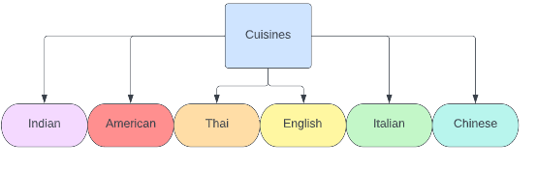
Our restaurant
Customer | Benefits | Value proposition | Critical success Factors
Employees of local area | - Affordable - High quality - Healthy - Delivery options - Halal | - Variation of foods - Employees are able to dine-in and discuss work relations | - Allows customers to choose any type of food they are wanting on that certain day - build a customer base by close relations - provide loyalty cards - employee discounts with certain businesses
Residents of local area | - Affordable - High quality - Healthy - Delivery options - Halal | - Variation of foods - Families can get together - Large seating for dine- in | - Allows customers to choose any type of food they are wanting on that certain day - build a customer base by close relations - provide loyalty cards -large accessible seating options
Students of local area | - Affordable - High quality - Healthy - Delivery options - Halal | - Students have workspace - More streams to socialise - Friendly environment | - Allows customers to choose any type of food they are wanting on that certain day - build a customer base by close relations - provide loyalty cards - low/discounted delivery fees - student discount
Commuters | - Accessible public transport - Quick - Dine-in - Halal | - Variation of foods - Onsite parking | - Allows customers to choose any type of food they are wanting on that certain day - build a customer base by close relations - discounted prices for large orders - large accessible seating options
Delivery service customers | - Pay online - No human contact - Halal | - Customer will not have to commute | - Allows customers to choose any type of food they are wanting on that certain day - discounted prices for large orders - speed of delivery
Our main goal is to open a fast-paced fast-food restaurant that will provide cuisines from all over the world, including those found in the big chains.
Not only will we develop healthier and less healthy alternatives, but we will also include organic and local products on our menus.

Slide 3
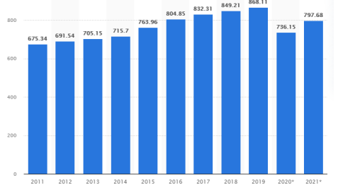
Is there an opportunity for us?
The fast food industry is increasing year on year however there is a lack of diverse cuisines under one roof
There are several fast-food businesses in Manchester, including the place where we will open, but many of them do not cater to all of the needs that people have, such as being halal.
Vegan choices are also becoming increasingly popular. We want to serve as many people as possible while maintaining within budget.
We are certain that we will be able to bring together this variety under one roof for all of our consumers due to the large number of commuters for work and education.
Young
Individuals who are on the move
Organic food
Variation of cuisines
Families
Students
Employees

Slide 4
Who are our competitors?
We will aim to compete with the 5 major chains in terms of EV’s being, Halal, organic, reasonable pricing, healthy options.
This ultimately is a coexistence of all requirements from the 5 major chains under one roof. We will not pursue kosher certification because the demand for kosher food is not large in this region; nonetheless, Halal food will be the primary goal.
 | KFC | McDonalds | Archies | Subway | Nando's | EVseatery
Halal | x | x | ✓ | ✓ | ✓ | ✓
Kosher | x | x | x | x | x | ✓
Vegan options | ✓ | ✓ | x | ✓ | x | ✓
Varied cuisines | x | x | x | x | x | ✓

Slide 5

Marketing strategy
Promotion
Loyalty programmes
Geo-Targeted ads
User generated content
Social media presence
Food blogger outreach
Price strategy
Sales strategy
Transaction streams
Competitive reaction
Launch strategy
Brand development
Growth
We will require an efficient marketing plan in order to sell our products/services. The major goal is to have as many marketing channels as possible to promote our company to as many people as feasible.

Slide 6
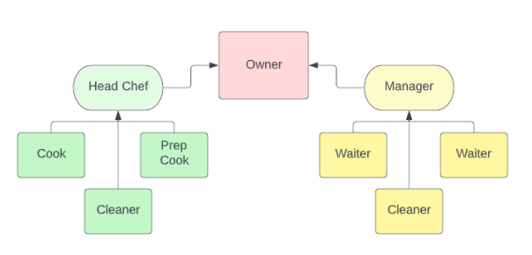
Management team
Mr. Aslam, a sole trader will be the owner of the company.
An assistant manager will also be hired to deal with additional tasks who will oversee the front of house.
A head chef will oversee the kitchen with the assistance of two chefs.
The bookkeeping for the restaurant will be completed by the owner where 4 main things will be carried out to ensure effective handling.
-Record sales
-Arrange accounts payable
-Reconciliation of accounts
- Analyse financial reports

Slide 7

Financial highlights
Key assumptions;
- 6.2% inflation
Following year 1 the performance will increase each year
8 employees
Average money spent per customer £9.60
Prices can vary from month to month especially in academic holidays

